Slide 1

Spring Cloud
Notes:
Just into on why we’re here today and what’s the point of having this presentation. Brifely touch the topic of presenters: SZ, OZ, IL, and KK.
In the end: passing the floot to Sviatlana.

Slide 2
Monolith vs microservices
Monolith
Microservices

Slide 3
Microservices: pros and cons
Pros of Microservices:
Easier Scaling Up
Improved Fault Tolerance
Ease of Understanding of the Codebase
Scope for Experimenting
Independent Deployment
Cons of Microservices:
Increased Complexity of Communication
Requires More Resources
Global Testing and Debugging is Difficult
Not Practical for Small Applications
Relatively Complex Deployment

Slide 4

Spring Cloud
Spring Cloud provides tools for developers to quickly build some of the common patterns in distributed systems:
configuration management,
service discovery,
circuit breakers,
intelligent routing,
control bus,
one-time tokens,
global locks,
leadership election,
distributed sessions,
etc.

Slide 5


Simple app
HTTP requests:
GET /hotels
JSON with all hotels
Hotel service

Slide 6
Config server
Spring Cloud Config – provides server-side and client-side support for externalized configuration in a distributed system. With the Config Server, you have a central place to manage external properties for applications across all environments.
The default implementation of the server storage backend uses git.

Slide 7
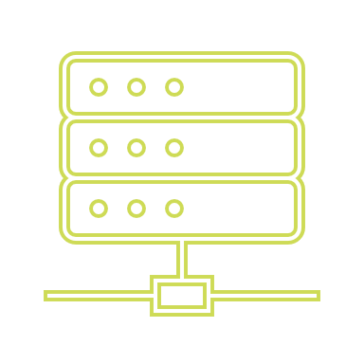

Config server
Re-initialize beans
Load props on startup
Reload props
User
Refresh
Config server
Hotel service
Admin

Slide 8

Config server
Service discovery – process of detecting services and devices in the network.
Microservice may use service discovery to find the address of another microservice instead of hardcoding it.
Spring Cloud Netflix Eureka provides both server and client for service discovery

Slide 9
Eureka
Hotel service
Load props on startup
User
Config server
HTTP request
Register
Request services
Register
Discount service
Eureka server

Slide 10
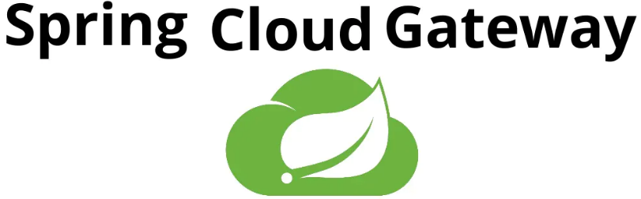
Config server
Spring Cloud Gateway aims to provide a simple, yet effective way to route to APIs and provide cross cutting concerns to them such as:
Security
monitoring/metrics
resiliency.

Slide 11
Gateway
Load configuration
/hotels
/discounts
User
Gateway
Hotel service
Eureka server
Discount service
Config server

Slide 12
API Gateway: pros and cons
Pros of Gateway:
Acts like a security barrier
Decreased microservice complexity – gateway may manage authentication, rate limiting, etc.
May provide deep insights into performance metrics
Cons of Gateway:
Additional layer that decreases performance
Can be a single point of failure
Requires additional configuration, maintenance, etc.

Slide 13
QA
Do you have any questions?

